Slide 1
Jetson 스펙 비교
2019년 6월 9일
성병문
한세대학교 자율비행

Slide 2
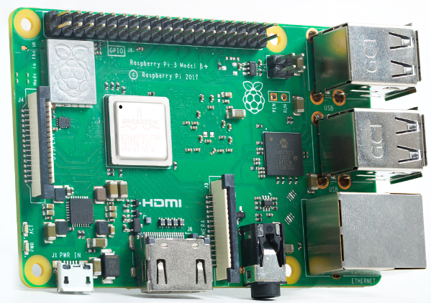
Raspberry Pi model 3 B+
PRICE : $35
SOC: Broadcom BCM2837B0, Cortex-A53 (ARMv8) 64-bit SoC
CPU: 1.4GHz 64-bit quad-core ARM Cortex-A53 CPU
RAM: 1GB LPDDR2 SDRAM
WIFI: Dual-band 802.11ac wireless LAN (2.4GHz and 5GHz ) and Bluetooth 4.2
Ethernet: Gigabit Ethernet over USB 2.0 (max 300 Mbps). Power-over-Ethernet support (with separate PoE HAT). Improved PXE network and USB mass-storage booting.
Thermal management: Yes
Video: Yes – VideoCore IV 3D. Full-size HDMI
Audio: Yes
USB 2.0: 4 ports
GPIO: 40-pin
Power: 5V/2.5A DC power input
Operating system support: Linux and Unix

Slide 3
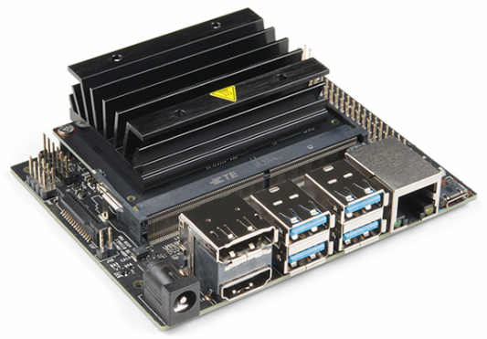
Jetson Nano
가격: $99
GPU: 128-core NVIDIA Maxwell™ GPU
CPU: Quad-core ARM® A57
Video: 4K @ 30 fps (H.264/H.265) / 4K @ 60 fps (H.264/H.265) encode and decode
Camera: MIPI CSI-2 DPHY lanes, 12x (Module) and 1x (Developer Kit)
Memory: 4 GB 64-bit LPDDR4; 25.6 gigabytes/second
Connectivity: Gigabit Ethernet
OS Support: Linux for Tegra®
Module Size: 70mm x 45mm
Developer Kit Size: 100mm x 80mm

Slide 4
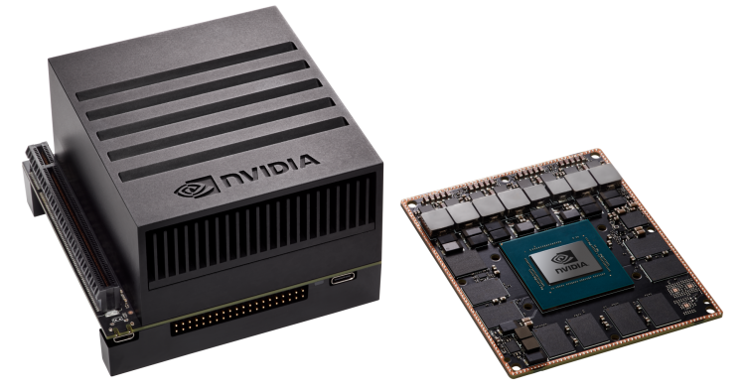
Jetson Xavier
PRICE | $ 1,100
GPU | 512-core Volta GPU with Tensor Cores
CPU | 8-core ARM v8.2 64-bit CPU, 8MB L2 + 4MB L3
Memory | 16GB 256-Bit LPDDR4x | 137GB/s
Storage | 32GB eMMC 5.1
DL Accelerator | (2x) NVDLA Engines*
Vision Accelerator | 7-way VLIW Vision Processor*
Encoder/Decoder | (2x) 4Kp60 | HEVC/(2x) 4Kp60 | 12-Bit Support
Size | 105 mm x 105 mm
Deployment | Module (Jetson AGX Xavier)

Slide 5
끝.

